Slide 1

Title of Presentation
Presenter Name¹, Coauthor Name²,
Coauthor Name^{1,2}, and Coauthor Name²
¹ Affiliation One
² Affiliation Two

Slide 2
Outline
Slide Format
Title Slide
Font Size
Presentation Guidelines
Presentation Flow
Text Slides
Graphs and Diagrams
Saving
Recording
Uploading

Slide 3
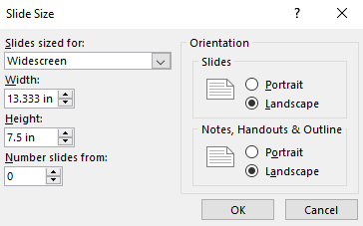
Slide Format: Requirements
Slides must be sized for Widescreen format (16:9) with 0.5 in margins.
Slide orientation must be Landscape (horizontal).
  In DESIGN tab, click on Slide Size and then select Widescreen.
  In Custom Slide Size, you will see:

Slide 4
Slide Format: Rules
Corporate and institutional logos are not permitted, except on the title slide.
Corporate and institutional backgrounds and borders are not permitted to avoid appearance of marketing.
Backgrounds must be white.
Text, lines, and shape outlines must be dark.
Text fonts must be appropriate for screen display.
  Recommended font: Trebuchet MS
  Reasonable alternatives: Arial or Verdana.

Slide 5
Title Slide: Requirements
Title slide must include:
  title of presentation,
  names and affiliations of all authors, and
  full name of presenter.
Full name of presenter must be underlined.
Superscripts may be used to indicate individual author affiliations.

Slide 6
Font Size: Rules
Title font size must be 40 pt.
Primary text font size must be ≥ 28 pt.
  Secondary text font size must be ≥ 24 pt.
All other text font size should be ≥ 24 pt, unless a smaller font is absolutely necessary.
Font sizes (including labels on diagrams & graphs) must always be ≥ 20 pt.

Slide 7
Presentation Guidelines: for Effective Presentations
Keep concepts as simple as possible.
Limit each slide to one main idea.
Use several simple diagrams rather than one complex diagram.
Use equations only if concepts cannot be clearly explained without equations.
Use duplicate copies of slides that will be used more than once during the presentation.
  Do not plan to go back to a slide during the presentation.
Rehearse the presentation aloud, preferably to a group of colleagues.

Slide 8
Presentation Guidelines: for Effective Recorded Presentations
Practice transition sentences as you advance to the next slide to sound more cohesive.
Unless you are the only author, use “we” instead of “I”.
Motion on the screen is useful to maintain the audience’s attention for a streamed presentation.
It is strongly recommended that you embed a video of you talking in a corner of the slideshow.
  If embedded video, it is best to leave a corner of the slide blank but make sure that the slide number is still visible.
Additionally, use animation (slide 11) and use the embedded pointing tools within Powerpoint to help focus viewers’ attention.

Slide 9
Presentation Flow
Title Slide
Outline Slide
  (outline of the presentation, not the paper)
Introduction, Motivation, Problems or Challenges
Details of Work
Comparison of Results with Previously Reported Work
Conclusion Slide
Backup Slide(s)
  (for potential use during question & answer period)

Slide 10
Presentation Flow:
Use Outline Slide as Section Breaks
Title Slide
Outline Slide
  (outline of the presentation, not the paper)
Introduction, Motivation, Problems or Challenges
  Gray out surrounding text
Details of Work
Comparison of Results with Previously Reported Work
Conclusion Slide
Backup Slide(s)
  (for potential use during question & answer period)

Slide 11
Text Slides
Use short phrases, not long sentences.
  OK to remove articles like “a”, “an”, and “the”
Slides with lots of words are hard for the audience to assimilate.
Minimize the number of words on text slides. Unless necessary:
  Use no more than 30 words per slide, and
  Use no more than 6 lines of text per slide.
“Acknowledgments” not “Acknowledgements”.
Might be useful to have slides checked by native English speaker.
  Please indicate early if you would like additional help from your session chair/co-chair

Slide 12
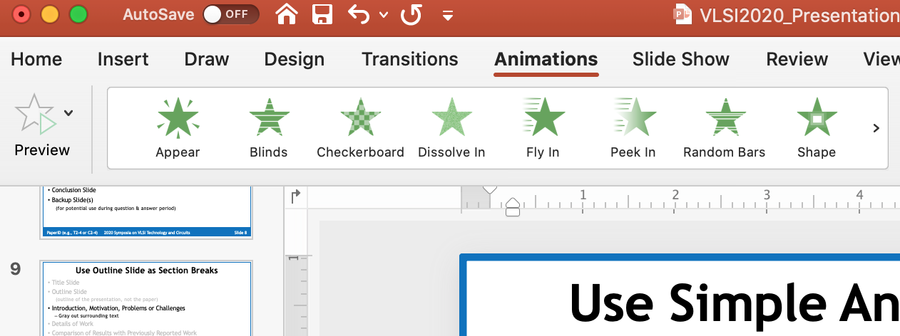
Successively Focus Audience on Slide Content
Within a slide, use simple animation to make things “Appear” successively within a slide.
Check the animation in Slide Show mode (see this slide as an example)
Make sure your speech integrates well with the timing of the animation
This creates change to your screen every 5-15 seconds instead of roughly every minute
Don’t use fancy animation as it may come across as a distraction

Slide 13
Slide Footer
Go to “View” tab and click on “Slide Master”
Update bottom left footer with your Program #
Do not delete bottom right footer “Slide <#>”
To exit, go to “Slide Master” tab and click on “Close Master”

Slide 14
Graphs and Diagrams
Simple line drawings are often best.
  Make all lines sufficiently thick.
  Dotted, dashed, and other specialty lines should be very bold and thick.
  Do not simply copy-and-paste figures from your paper.
Fonts within graphs and diagrams should be ≥ 24 pt.
Often, graphs imported from other applications (e.g., Matlab) have small fonts & thin lines.
  Adjust settings of the applications to increase font size and line thickness, or
  Import data and produce graphs using PowerPoint.
Annotating plots with text may be easier to follow than using a legend
Avoid red lines in black as color-blind people have difficulty seeing red
Apply shadow to your text inside figures if more contrast is needed

Slide 15
Example of Good Figure

Slide 16
Example of Bad Figure
Thin Lines, Small Fonts

Slide 17
Saving Your File
Embed TrueType fonts in your file
  Click on “File”, “Save As”, “Tools”, “Embed True Type Fonts”, or
  Click on “File”, “Save As”, and check “Embed True Type”
Save your file with the name pattern - Session number_your name (FamilyName)
Examples:
  T1-1_name (Technology Symposium, Session 1, Paper 1)
  C2-3 _name (Circuits Symposium, Session 2, Paper 3)
  JFS3-4_name (Joint Focus Session 3, Paper 4)
  SC1-5_name (Short Course 1, 5th presentation)
  F2_name (Forum, 2nd presentation)

Slide 18
Recording: Video Conferencing Tools
Several video conferencing tools are available to easily record a presentation. You can show your face through the web cam method (highly recommended and encouraged), while displaying your slides as you talk.
You can use any meeting software as long as you get a good quality recording and your final file is in the MP4 format.
Links to instructions on recording a meeting on common platforms
Webex
Skype
Google Meet
Zoom
GoToMeeting
Microsoft Teams
You can also record your video using Vidyard. Links to your session day will be in Map Your Show when you log on.

Slide 19
Recording: PowerPoint
You can also use this two-step method available in PowerPoint.
1. Create Voice-Over PowerPoint
Record a slide show with narration and slide timings
2. Convert to MP4
How to Save Voice Over PowerPoint (VOPPT) to MP4

Slide 20
Recording: File Requirements
• All files must be in MP4 format. File size should be less than 300MB and follow the recommendations below for optimum playback experience for the viewers.
Bit rate
Do not exceed 2,000kbps bit rate.
To check the bit rate, right click on the file name, click on properties, go to the Details tab, and look for Total Bitrate. If the bit rate is too high, please lower the quality to “Internet Quality” to create the MP4.
• Resolution
- 1280p x 720p (16:9)
Note
Please continue to record (without further speaking) for an additional 3–5 seconds at the conclusion of your presentation to ensure nothing is cut-off at the end of your video during playback when your video is integrated into online platform.

Slide 21
Recording: Tips-1
1. Equipment
Strong Wi-Fi (or wired) Internet connection.
Use a good headset with microphone close to mouth BUT away from direct line of mouth to reduce “pops”, avoid using your computer’s laptop or desktop built-in microphone.
Do a test recording for a couple of minutes and review the sound and picture quality, MP4 format, and bit rate before recording the entire presentation.
2. Room
As quiet as possible.
Avoid areas that have an echo. Your recording room should be fairly small with sound dampening from carpet, curtains, and furniture.
No interruptions (e.g., kids or pets coming in).
Plain background to eliminate viewer distractions, no company logos.
Make sure there is ample lighting.
3. Attire
Business casual (at a minimum).

Slide 22
Recording: Tips-2
4. Presentation slides
Do not use small fonts in your presentation as they may be difficult to see on some laptop monitors. All font sizes should be at least 20.
Insert slides with main section breaks into your slide deck to make the progress of your presentation easier to follow. In this slide, keep the section you are about to present in black and the other sections in gray.
Within a slide, use animation to make things "Appear" successively within a slide. This creates change to your screen every 5-15 seconds instead of roughly every minute.
5. Attracting and maintaining viewer’s attention
It is strongly recommended that you also record, alongside your presentation slides, a nonstatic video caption of yourself in the lower right corner of your presentation.
Speak with a lively voice and vary the tone of your voice to keep your talk fresh and interesting.
Avoid awkward pauses that last a few seconds.
Record your presentation with the PowerPoint “Laser Pointer” turned on and use your mouse to move the laser pointer around what you want to focus the listener to.
Speak with a lively voice and vary the tone of your voice to keep your talk fresh and interesting.

Slide 23
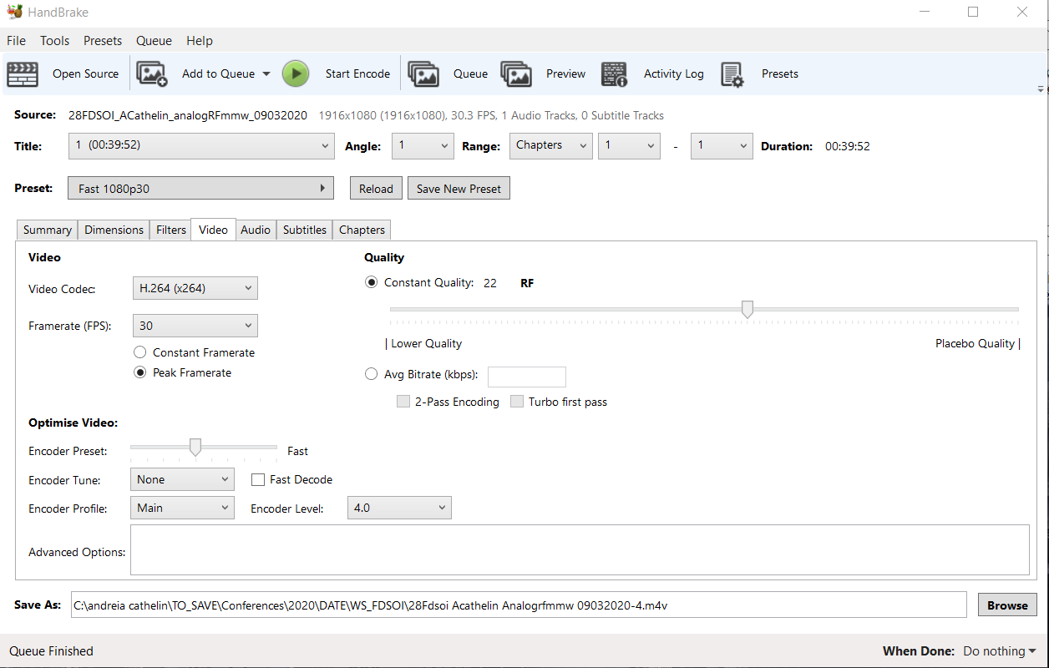
Recording: Tips-3-Compression
Compress the resulting mp4 with a video compression tool. We recommend handbrake, which has a portable and free of charge version: https://handbrake.fr/rotation.php?file=HandBrake-1.3.2-x86_64-Win_GUI.zip
Several settings can be tried; we recommend the following combination:
Video: keep it as it is:

Slide 24
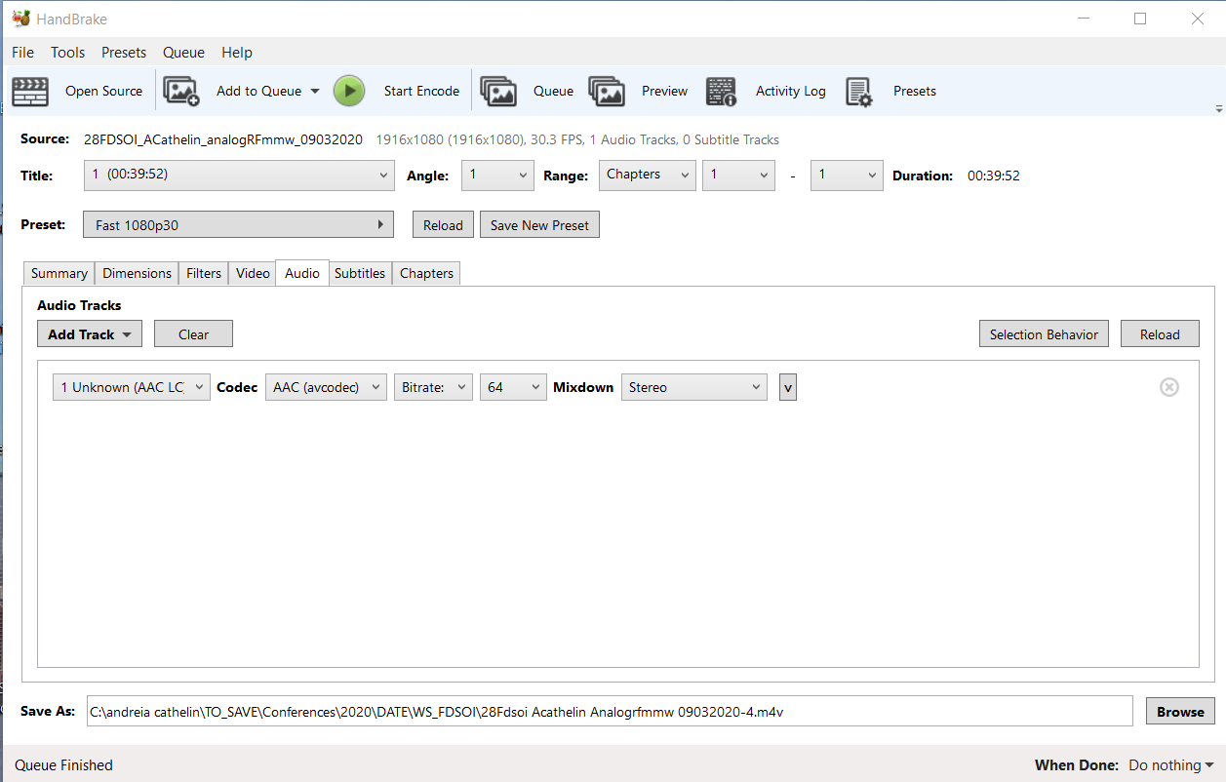
Recording: Tips-4
Audio: apply some compression. We recommend go to AAC 64kb bitrate.

Slide 25
Uploading: MP4 Files and PDF Slides
Deadline: May 24, 2024(PST)
Prior to uploading your complete MP4 files and PDF file of your original presentation slides need to be confirmed by your session chairs. Please check your email and spam folder for communications.
Note
MP4 files cannot be downloaded from the virtual platform.
Attendees are allowed to download the PDF slides from the virtual platform. Feel free to remove any confidential information you don’t want to share in these slides.
In case you would like to resubmit MP4 or PDF files after uploading, please just upload the revised files. The Secretariat will use only the latest files to be linked with the virtual platform.

